Slide 1
Nonlinear Tax-Induced Migration : An Overlooked Tale
Yizhou Zhangª* and Geoffrey J.D. Hewings^{b}
ª Regional Economics Applications Laboratory AND Department of Agricultural and Consumer Economics, University of Illinois at Urbana-Champaign,
^{b} Regional Economics Applications Laboratory, University of Illinois at Urbana-Champaign

Slide 2
Motivation
Tax policies are an important tool in the regional competition for skilled migrants. In the US, states openly compete for business activities and high-skill workers by offering lower taxes.
The existing literature on tax-induced migration (TIM) has mainly focused on the estimation of the average elasticity of migration to taxes but has largely ignored the variance around these estimates. This might has important policy consequences.
This paper aims to fill this literature gap by investigating nonlinear effects of taxes on migration.

Slide 3
Literature Review
Researchers have found empirical evidence for tax-induced labor migration (see, for example, Bakija and Slemrod 2004; Cohen et al. 2011; Akcigit et al. 2016; Kleven et al. 2013; 2014; Moretti and Wilson, 2017).
The TIM literature has focused on estimating the average elasticities without considering the variation of marginal effects, with a few exceptions.

Slide 4
Nonlinear Tax-Induced Migration
Coomes and Hoyt (2008) found that migration between MSAs was most responsive to tax differences above a threshold level of 1.5 percentage points and between areas that did not have reciprocity agreements
However, it was not clear why they chose the 1.5 percent threshold, nor was there any discussion of the marginal effects above 1.5 percent
Hsing (1995) and Hsing and Mixon (1996) built on the work of Cebula (1990) and identified a quadratic relationship between tax and migration.
However, the papers did not fully develop theoretical frameworks for labor migration, and no specific reason was provided to adopt a quadratic model as opposed to other models
Basile and Lim (2017) found a threshold pattern in the effect of regional wage differentials on migration
However, the authors did not quantify how migration flows change marginally at the threshold values

Slide 5
Potential Literature Gap
The present paper develops the research of nonlinear TIM in two ways.
First, we investigate and compare the nonlinear effects of different demand- and supply-side taxes on labor migration. Corporate Income Tax compared with Individual Income Tax
Secondly, spline regression traces the marginal effects of taxes avoiding ad hoc choices of nonlinear model or critical points of interests

Slide 6
Theoretical Framework: Labor Migration
A logistic model and its variants have been widely used in the place-to-place labor migration literature (Gabriel et al.1987; Gabriel et al. 1992,1993; Gabriel et al. 1995; Sasser 2010; Kleven et al. 2013; Cohen et al. 2011). The underlying assumption is that individuals make pairwise comparisons between alternative origin-destination pairs and choose the pair that yields the highest expected utility gain from migration. Moretti and Wilson (2017) modified the model to incorporate corporate migration:
$$\log\left(\frac{P_{ijt}}{P_{iit}}\right)=\sum_{k∈Tax}{α_{k}\left[\log\left(\frac{1−π_{kjt}}{1−π_{kit}}\right)\right]}+\sum_{h∈Cred}{β_{h}\left[\log\left(\frac{τ_{hjt}}{τ_{hit}}\right)\right]}+γ_{i}+γ_{j}+γ_{ij}+γ_{t}+X_{it}−X_{jt}+u_{ijt} (1)$$

Slide 7
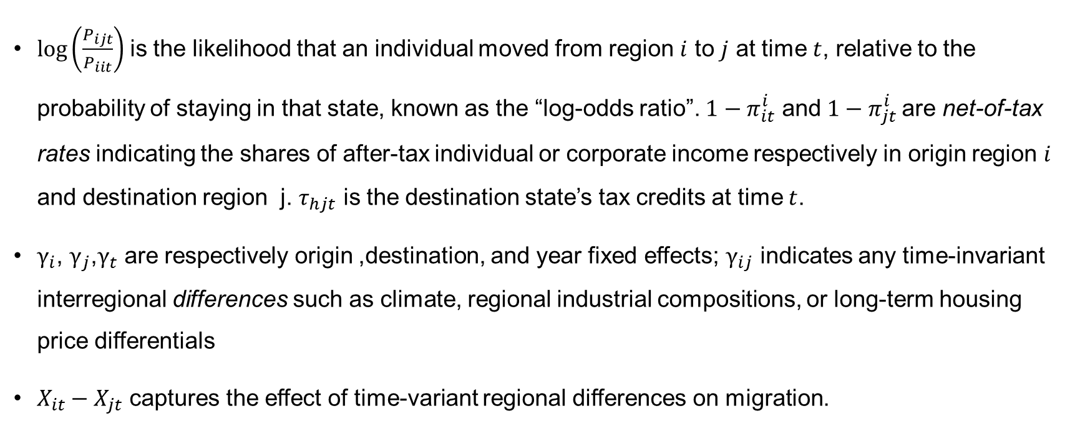
$$\log\left(\frac{P_{ijt}}{P_{iit}}\right)=\sum_{k∈Tax}{α_{k}\left[\log\left(\frac{1−π_{kjt}}{1−π_{kit}}\right)\right]}+\sum_{h∈Cred}{β_{h}\left[\log\left(\frac{τ_{hjt}}{τ_{hit}}\right)\right]}+γ_{i}+γ_{j}+γ_{ij}+γ_{t}+X_{it}−X_{jt}+u_{ijt} (1)$$
$\log\left(\frac{P_{ijt}}{P_{iit}}\right)$is the likelihood that an individual moved from region $i$ to $j$ at time $t$, relative to the probability of staying in that state, known as the “log-odds ratio”. $1−π_{it}^{i}$ and $1−π_{jt}^{i}$are net-of-tax rates indicating the shares of after-tax individual or corporate income respectively in origin region $i$ and destination region j. $τ_{hjt}$ is the destination state’s tax credits at time $t$.
$γ_{i}$, $γ_{j}$,$γ_{t}$ are respectively origin ,destination, and year fixed effects; $γ_{ij}$ indicates any time-invariant interregional differences such as climate, regional industrial compositions, or long-term housing price differentials
$X_{it}−X_{jt}$ captures the effect of time-variant regional differences on migration.

Slide 8
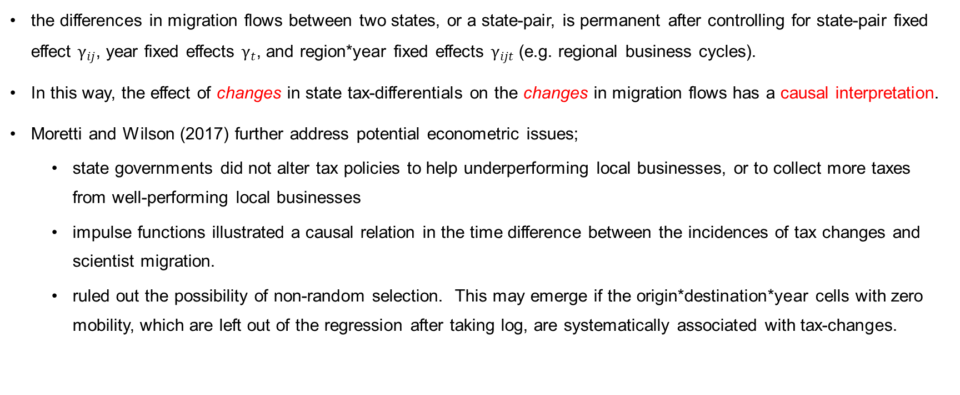
Key Identification Assumptions
the differences in migration flows between two states, or a state-pair, is permanent after controlling for state-pair fixed effect $γ_{ij}$, year fixed effects $γ_{t}$, and region*year fixed effects $γ_{ijt}$ (e.g. regional business cycles).
In this way, the effect of changes in state tax-differentials on the changes in migration flows has a causal interpretation.
Moretti and Wilson (2017) further address potential econometric issues;
state governments did not alter tax policies to help underperforming local businesses, or to collect more taxes from well-performing local businesses
impulse functions illustrated a causal relation in the time difference between the incidences of tax changes and scientist migration.
ruled out the possibility of non-random selection. This may emerge if the origin*destination*year cells with zero mobility, which are left out of the regression after taking log, are systematically associated with tax-changes.

Slide 9
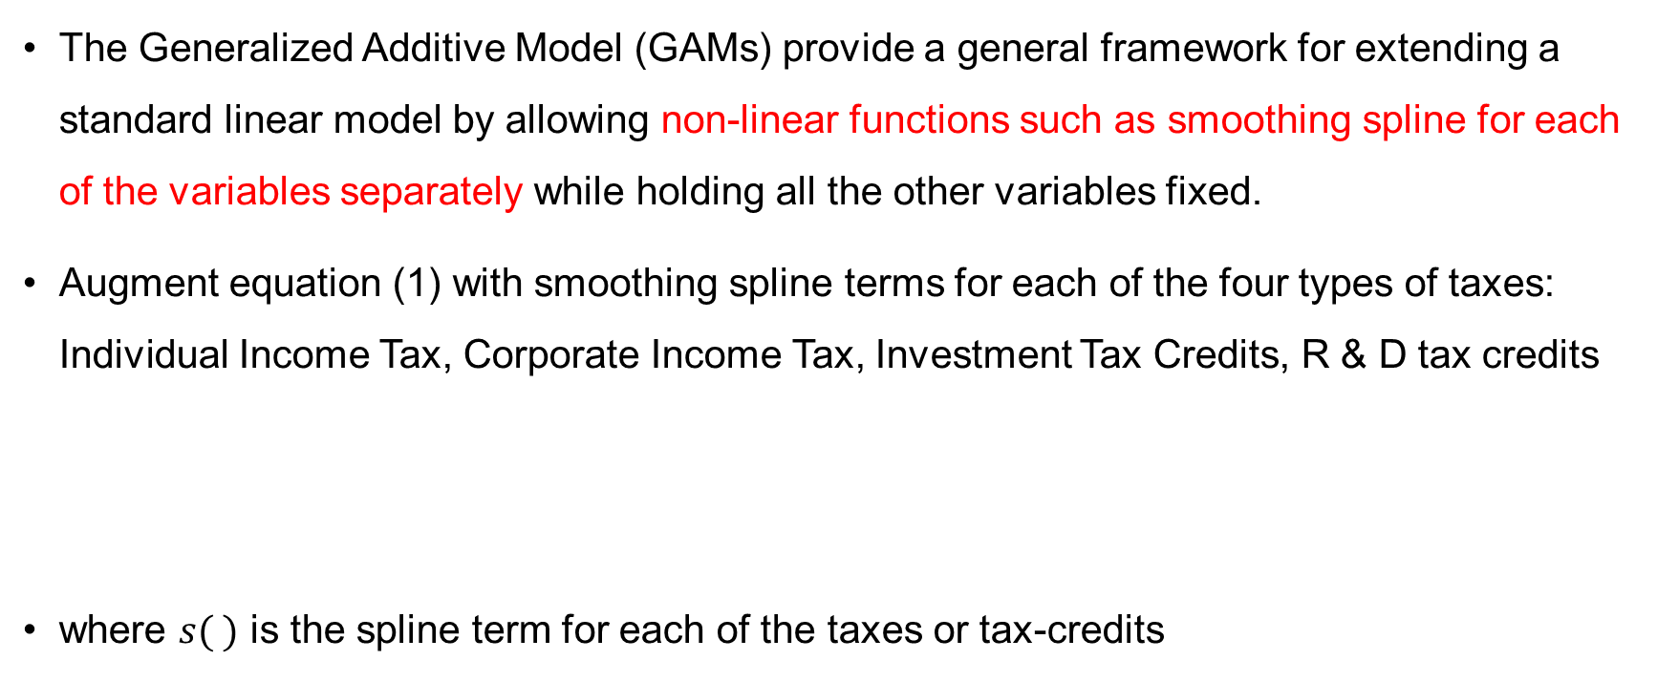
Spline Regression
The Generalized Additive Model (GAMs) provide a general framework for extending a standard linear model by allowing non-linear functions such as smoothing spline for each of the variables separately while holding all the other variables fixed.
Augment equation (1) with smoothing spline terms for each of the four types of taxes: Individual Income Tax, Corporate Income Tax, Investment Tax Credits, R & D tax credits
where $s( )$ is the spline term for each of the taxes or tax-credits
$$\log\left(\frac{P_{ijt}}{P_{iit}}\right)=β_{0}+\sum_{k∈Tax}{s\left[\log\left(\frac{1−π_{kjt}}{1−π_{kit}}\right)\right]}+\sum_{h∈Cred}{s\left[\log\left(\frac{τ_{hjt}}{τ_{hit}}\right)\right]}+γ_{t}+γ_{ij}+γ_{ijt}+ {u }_{ijt}$$

Slide 10
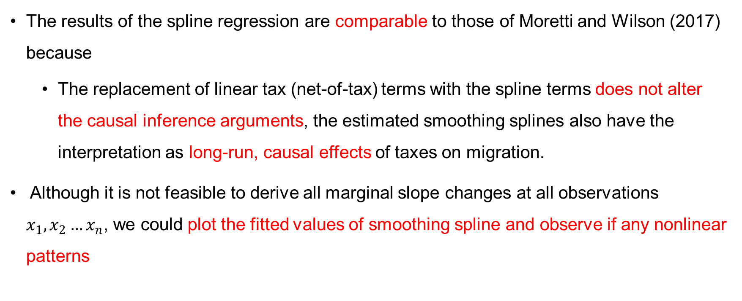
Spline Regression
The results of the spline regression are comparable to those of Moretti and Wilson (2017) because
The replacement of linear tax (net-of-tax) terms with the spline terms does not alter the causal inference arguments, the estimated smoothing splines also have the interpretation as long-run, causal effects of taxes on migration.
Although it is not feasible to derive all marginal slope changes at all observations $x_{1},x_{2}…x_{n}$, we could plot the fitted values of smoothing spline and observe if any nonlinear patterns

Slide 11
Data
Moretti & Wilson combined the scientists location/patent information in COMETS dataset (Zucker, Darby, & Fong, 2011) to data on state taxes from Chirinko & Wilson (2008)
“star scientists”: in a given year, as those that are at or above the 95th percentile in number of patents over the past ten years.
Potential [(51*51) – 51]*(2009-1977) = 84,150 origin*destination*year cells. Among them, 15,247 have positive migration flows.
Four types of taxes:
ATR = average tax rate in a state faced by a hypothetical taxpayer at the 99th percentile of the national income distribution. top scientists are assumed to be in this income category, as the COMET dataset does not have income information.
CIT = effective corporate income tax , incorporating both federal and state rates.
ITC = corporate investment tax credit
R & D cred = each state’s R&D tax credit. It can be given to both individual and corporates.

Slide 12
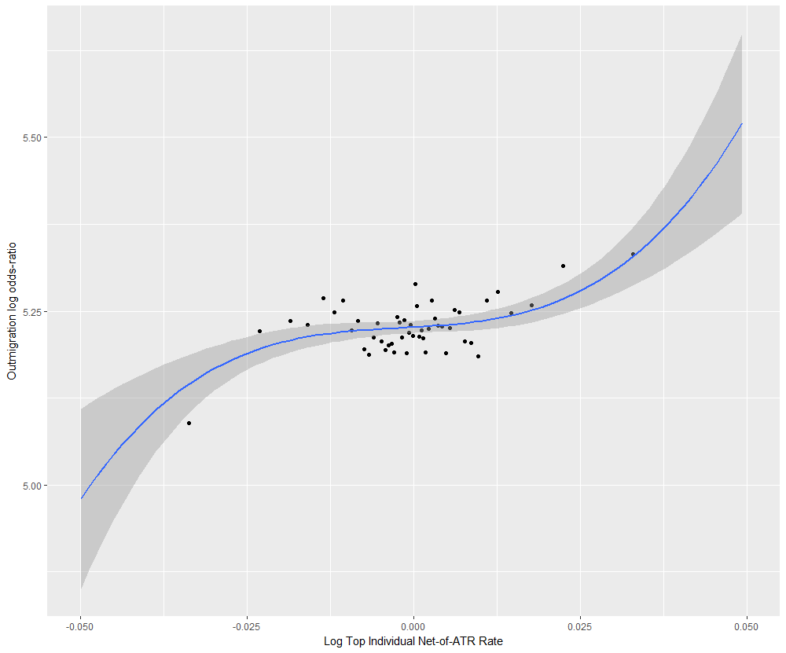
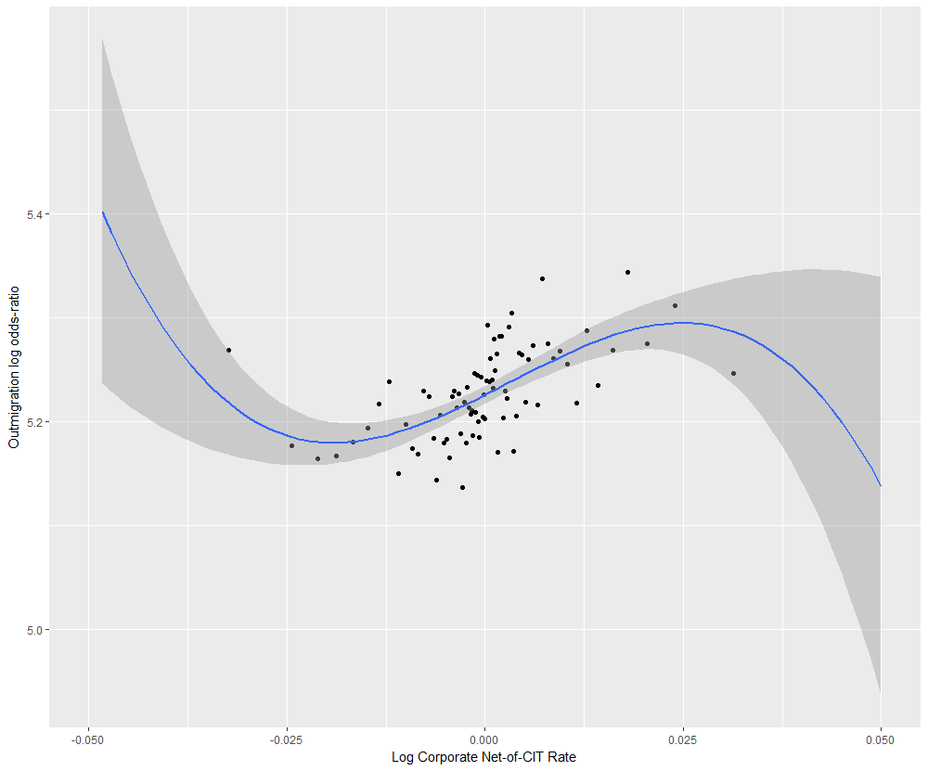
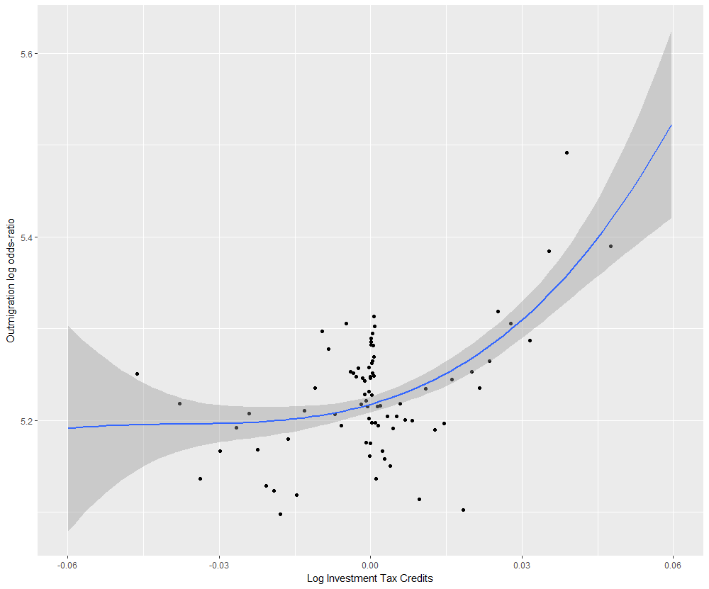
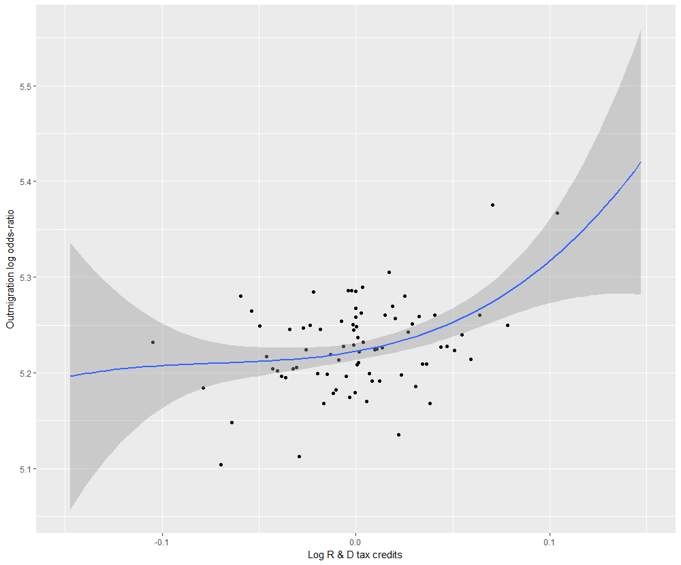
Graphical Evidence: Nonlinear TIM
bin-scatterplots of the log odds-ratio against the log net-of-tax rates controlling for state-pair and year fixed effects
ATR
CIT
ITC
R & D Credit

Slide 13
Empirical Results
Table 1: Spline Regression Results
 | edf | Ref.df | F | p-value
s(ATR) | 7.556 | 8.531 | 6.83 | 2.02e-09 ***
s(CIT) | 8.265 | 8.871 | 6.839 | 7.82e-10 ***
s(ITC) | 8.332 | 8.877 | 13.732 | < 2e-16 ***
s(R and D cred) | 8.765 | 8.981 | 9.697 | 4.73e-14 ***
n = 15226, R-sq.(adj) = 0.825 , Deviance explained = 85%
Note: the first two columns are the values of equivalent degrees of freedom, or the most suitable degrees of polynomials to approximate the spline term. The third column is the F-statistics, and the fourth column is the p-values associated with a linear null hypothesis.
Table 1 summarizes the result of fitting the spline augmented GAM in equation (3). Each of the four p-values corresponds to a null hypothesis of a linear relationship versus the alternative of a non-linear relationship (James et al., 2013). The significance levels provide clear evidence that all four taxes or tax credits have nonlinear effects on scientist migration.

Slide 14
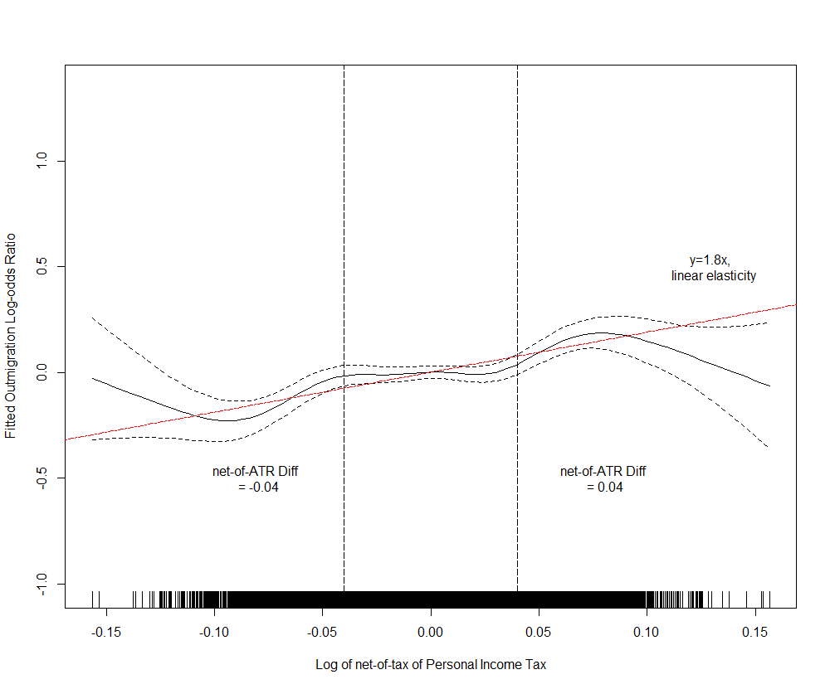
Net-of-Individual Average Income Tax Rate (ATR)
The y axis reports the fitted values of the log-odds ratio; the x axis reports the log of interregional tax differentials (net-of-ATR).
The red dotted lines display the average elasticities estimated in Moretti and Wilson (2017).
The wide confidence intervals at the outer range of tax differentials is typical of spline regression (James et al., 2013).
A clear threshold pattern for ATR: the slope of the fitted value curve increases more rapidly after a 4 percent differentials is reached.

Slide 15
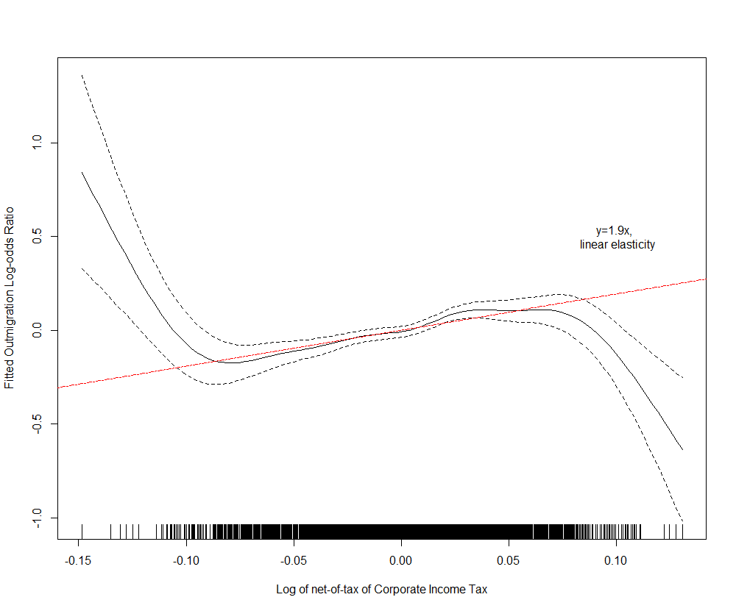
Corporate Income Tax (CIT)
a mainly linear effect on migration throughout most of the range of CIT
The fitted curve compatible with the average elasticity estimated in Moretti & Wilson 2017.

Slide 16
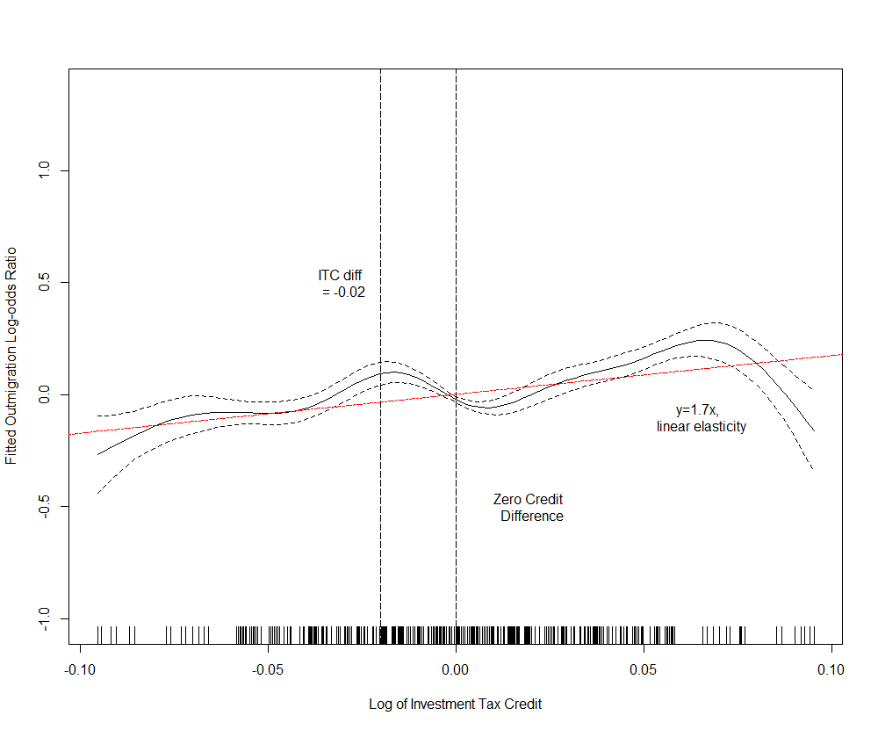
Investment Tax Credit (ITC)
ITC has a linear effect when there is higher tax credit in the destination state than in the origin state,
but the effects vacillate between positive and negative values without clear interpretation when the origin state initially had higher tax credits

Slide 17
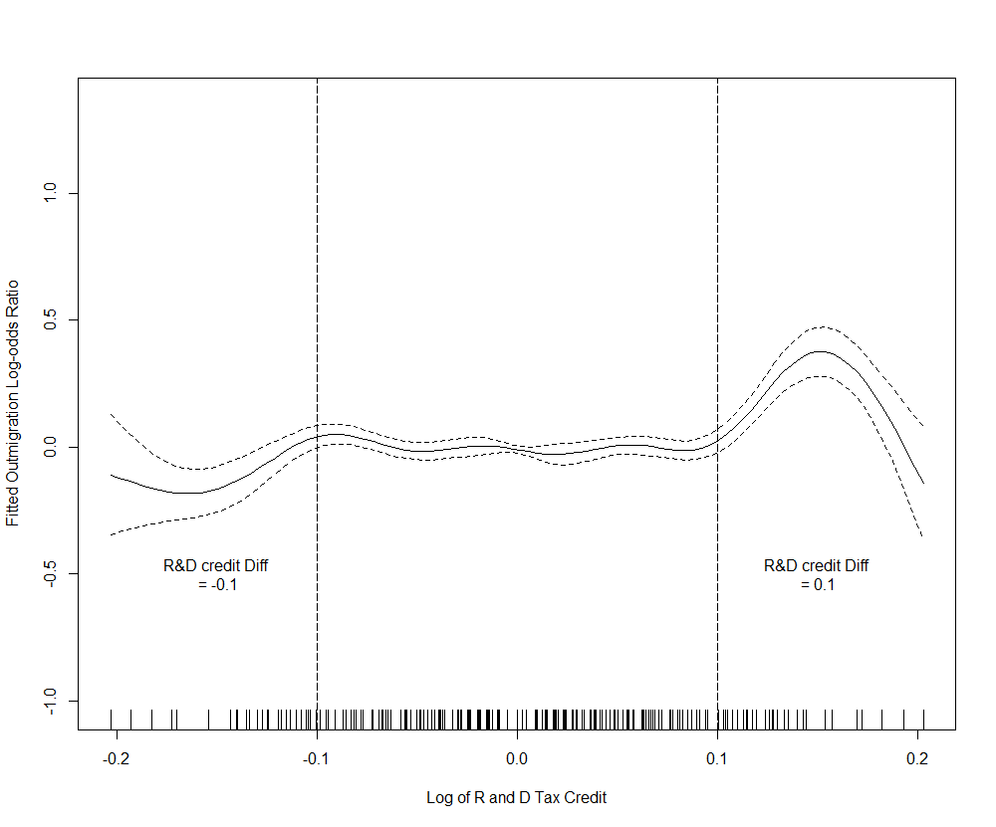
R and D tax credit
R and D tax credit also has a threshold pattern like net-of-ATR but with greater thresholds: credit differentials impact migration only when they exceed 10 percent.

Slide 18
Binned Regression: Quantify Marginal Effect Changes
Plotting the fitted valus present the general nonlinearity patterns of the taxes but do not quantify marginal effect changes
Bin regression augments the linear model with interaction terms corresponding to nonlinear effects

Slide 19

Interpreting NonLinear TIM
For ATR, a 4 percent net-of-tax differential would not induce changes in migration flows. An Inertia Range
Linear Effect for CIT: an additional 1% increase in net-of-tax in $destination$ j would linearly induce a 1.55 percent migration-flow increase from $i$ to $j$,
Asymmetric pattern for ITC: if the net-of-tax is originally higher in $j$, then a 1% increase in $j$’s credit would result in a 2.77 percent increase in the migration flow from $i$ to $j$. Not consistent effect if $j$ originally has lower credit than $i$
For R and D credit, an inertia range is between -0.1 and 0.1

Slide 20
Conclusion
Different nonlinear effects for four types of taxes or tax credits on migration.
personal income taxes and research and development tax credit have threshold patterns, meaning that the migration flows of scientists only respond to net-of-tax or credit differentials that are outside the “inertia ranges.”
Corporate income taxes have an overall linear effect; migration flows have a stable response to CIT changes and raising the net-of-tax in the destination state attracts migrants from other states
investment tax credits have consistently positive effects on migration only when the destination state initially had higher tax credits than the origin state. In other words, raising tax credits in the destination state would not consistently attract migrants from other states that initially have a higher level of tax credits
Decision makers need to be cautious about the use of the average TIM elasticities. A state attempting to adjust tax rates needs to consider not just the opportunity cost of lost revenue (due to the downward adjustment of tax rates) but the probability that the anticipated in-migration of skilled workers/businesses will occur.

